Slide 1
Workshop Creating Oracle JET Composite Components with OpenLayers GIS library
nlOUG Oracle Developer Meet Up
Lucas Jellema
Tuesday 3rd April, Oracle The Netherlands

Slide 2




Referencing JET Composite Components
Meta data file describing JET Composite Components used in a JET application and to be managed by jccm. Located in src/js/jet-composites
Name
Version (min/max)
Git tag/commit/branch
URL (zip, Git Repo, Live JET app)
Phase (design, build, deploy, run, request
Command Line Interface that is run for a specific phase (install, build, deploy, run, request) reads jet-composites.json and fetches JET-Composites as required – storing them in /src/js/jet-composites/<name of component>
jet-composites.json
Locations from where JET Composites can be retrieved: - Git (incl GitHub and BitBucket) - the JET Composite Components showroom
- Live JET Application
- A zip-file at a URL
jccm
(JET Composite Componen Manager CLI)
Design/Install time
Build time
Deployment time
Run time
Request time
Use jccm install to fetch composite components and save in application
Before/ at the start of ojet build, use jccm to add in Composite Components
After launching node, fetch composite components and write to local file system before starting to serve JET application
Manual, scheduled or WebHook trigger (e.g. from Git) to (re-)fetch the source of the composite component and write to local file system
Any request for artefacts of the JET Composite Component is redirected – the artefact is fetched live from a specified location (possibly with caching)

Slide 3
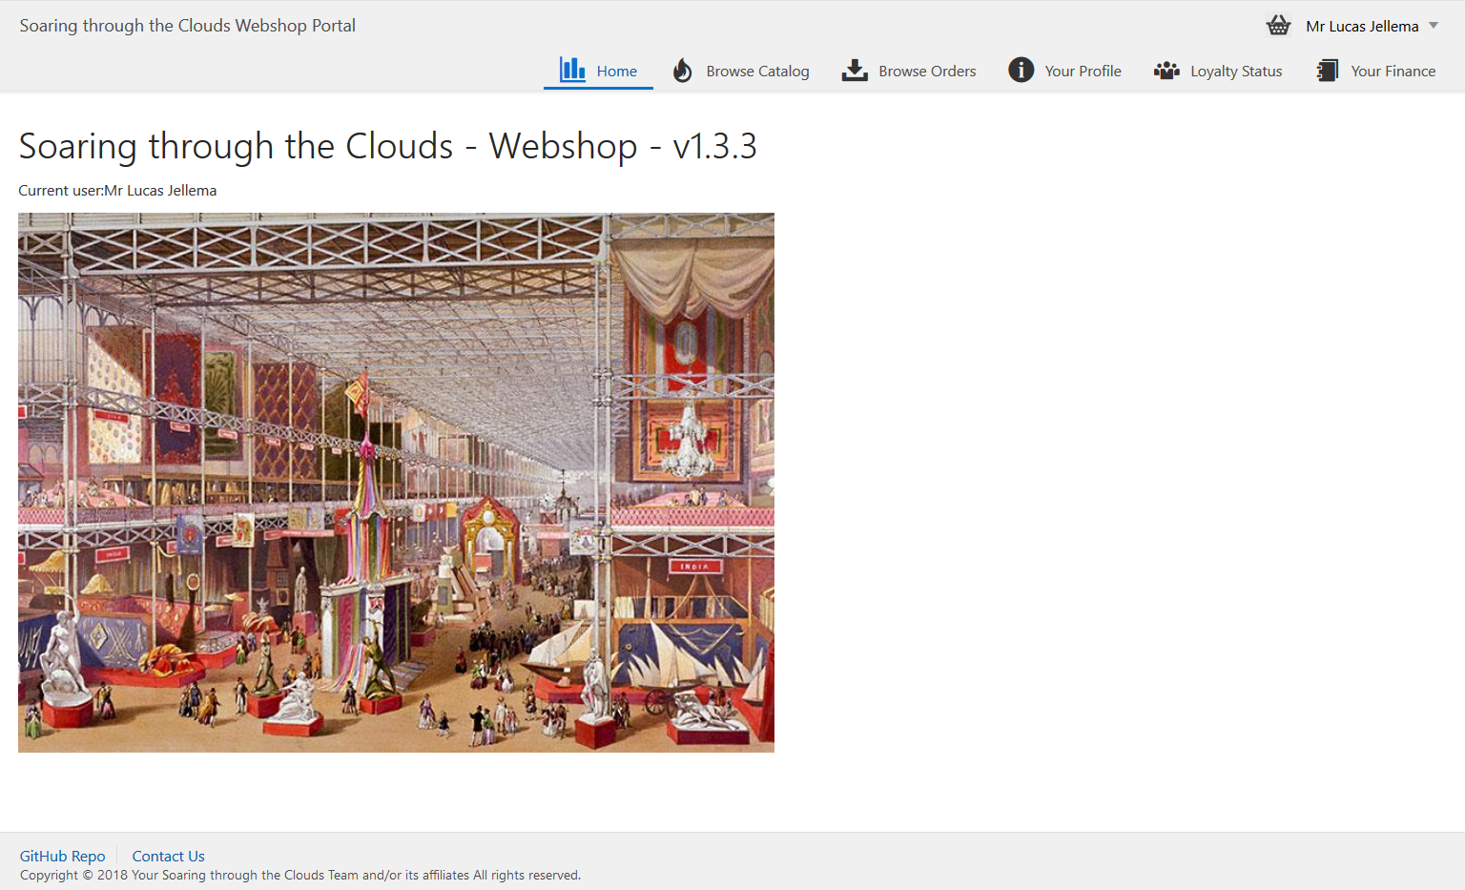
Demo of Referencing JET Composite Components
jccm
(JET Composite Componen Manager CLI)
jet-composites.json
name: Comp1
version : >= 1.2
commit: <git commit>
url : <github repo url>
phase : design
name: Comp2
version : 1.0
url : <showroom>
phase : deploy
name: Comp3
branch: master
url : <github repo url>
phase : runtime
name: Comp4
url : <live app url>
phase : request

Slide 4
Agenda
Introduction of OpenLayers
Demo: Using OpenLayers in JET Applications
Hands-on: OpenLayers in JET Applications
Dinner
Introduction JET CCA Composite Components
Demo: Creating a JET Composite Component based on OpenLayers
Hands-on: Building JET Composite Components
With Rich Geo functionality based on OpenLayers

Slide 5
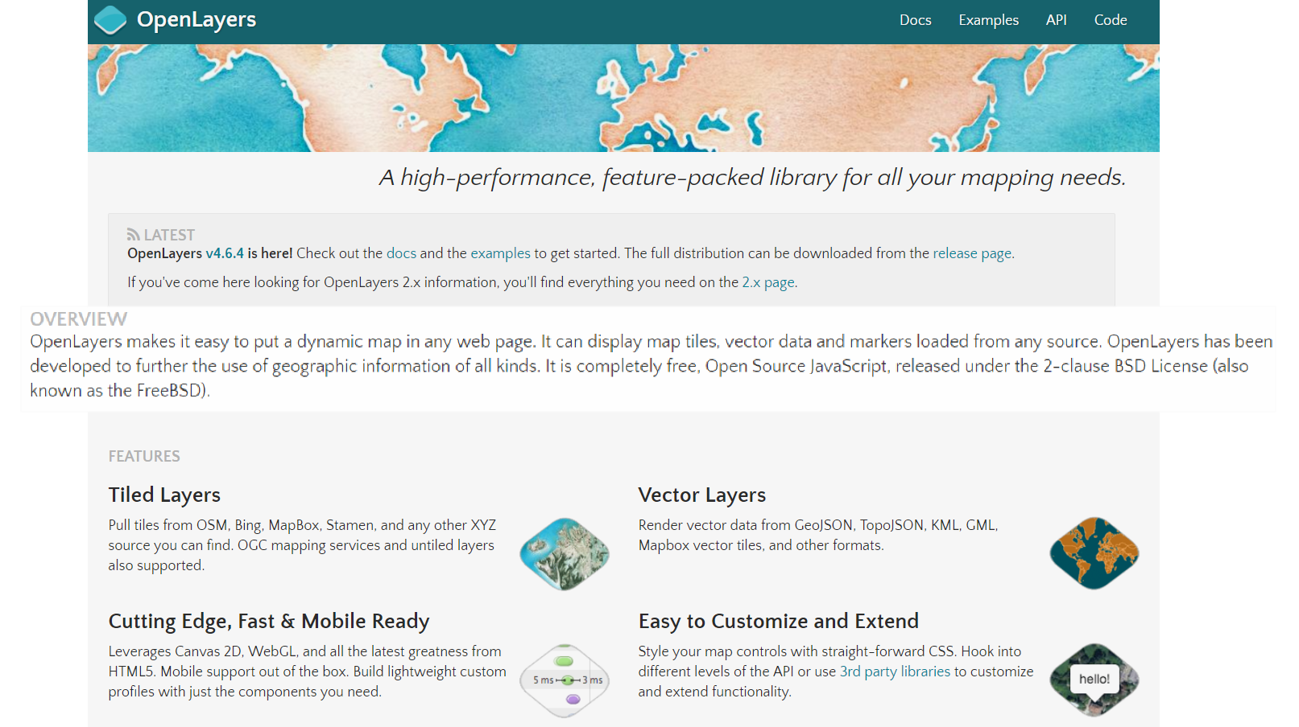
Introducing OpenLayers (open source, HTML5, JavaScript)
Notes:
Examples: http://openlayers.org/en/latest/examples/
API: http://openlayers.org/en/latest/apidoc/
Quickstart: https://openlayers.org/en/latest/doc/quickstart.html
On Line Editor: http://programmerg.github.io/ol3editor/

Slide 6

OpenLayers - Summary
Initial release: 2006
Most recent release: 4.6.4, early 2018
Since 2007 under Open Source GeoSpatial Foundation (OSGeo)
Originally based on Prototype JavaScript Framework; still fully (client side) JavaScript
Support for GeoRSS, KML (Keyhole Markup Language), Geography Markup Language (GML), GeoJSON and map data from any source using OGC-standards as Web Map Service (WMS) or Web Feature Service (WFS).
Map sources include Bing, Open Street Map, MapBox, Stamen, ArcGis (Esri)
Notes:
https://en.wikipedia.org/wiki/OpenLayers
https://en.wikipedia.org/wiki/Open_Source_Geospatial_Foundation
https://en.wikipedia.org/wiki/OpenStreetMap
Sites using OpenLayers: https://www.wappalyzer.com/technologies/openlayers

Slide 7
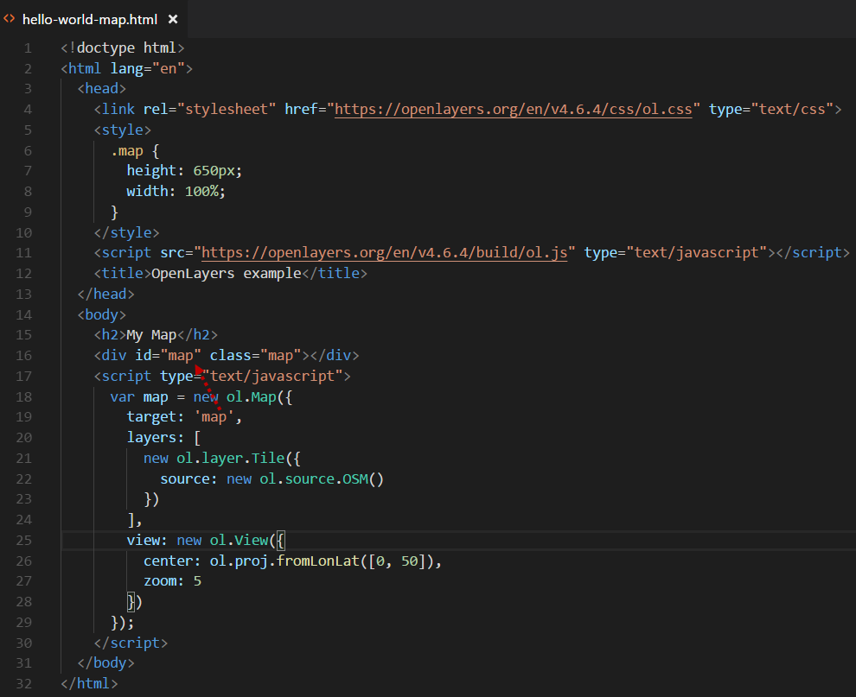
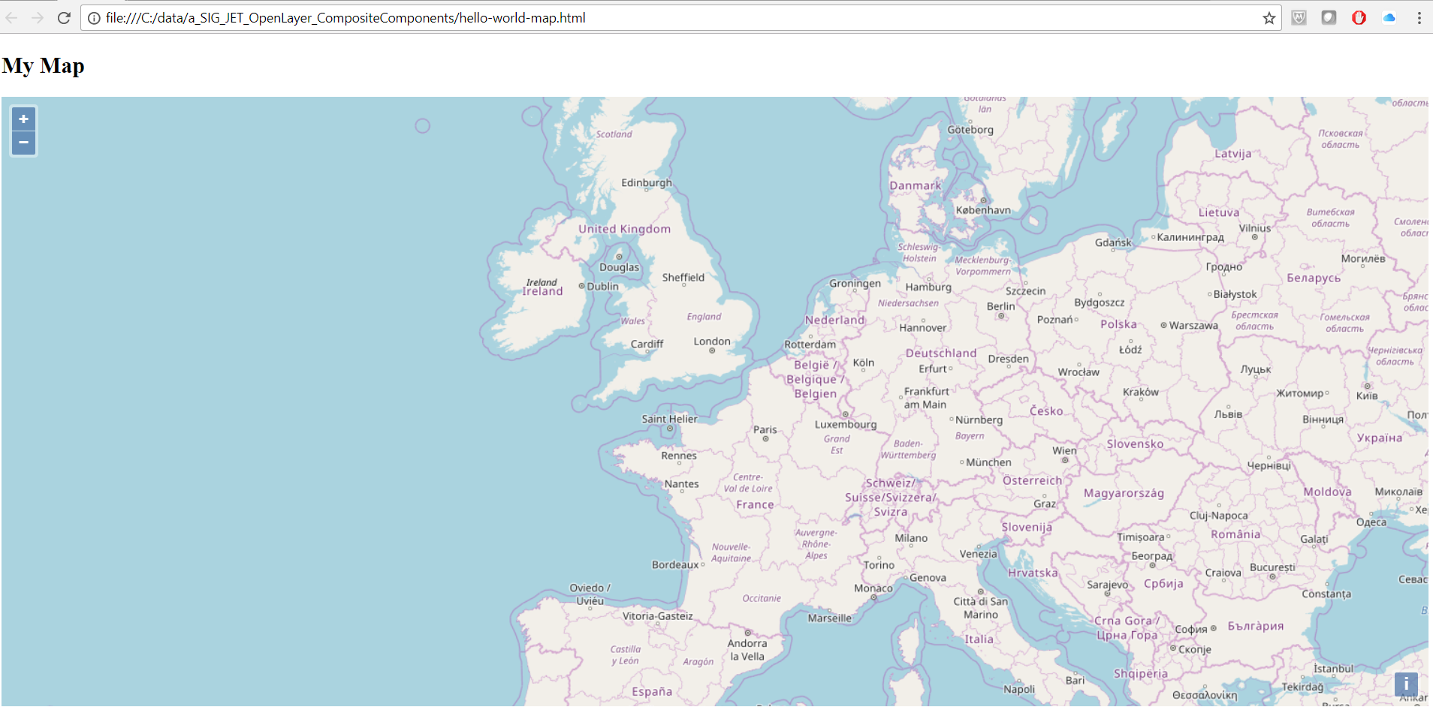
Hello World Map
Notes:
https://openlayers.org/en/latest/doc/quickstart.html

Slide 8
Key Concepts in OpenLayers
Map – associated with container DOM element
Layers – based on [URL to] source external services like OpenStreetMap or Bing or local Vectors
View – to specify projection, center and zoom-level for map
Style – specify the fill, stroke (color, width), text for features to be rendered
Vector – collection of features to render client side on a map [layer]
Interaction – user actions on the map to which functions can be tied

Slide 9
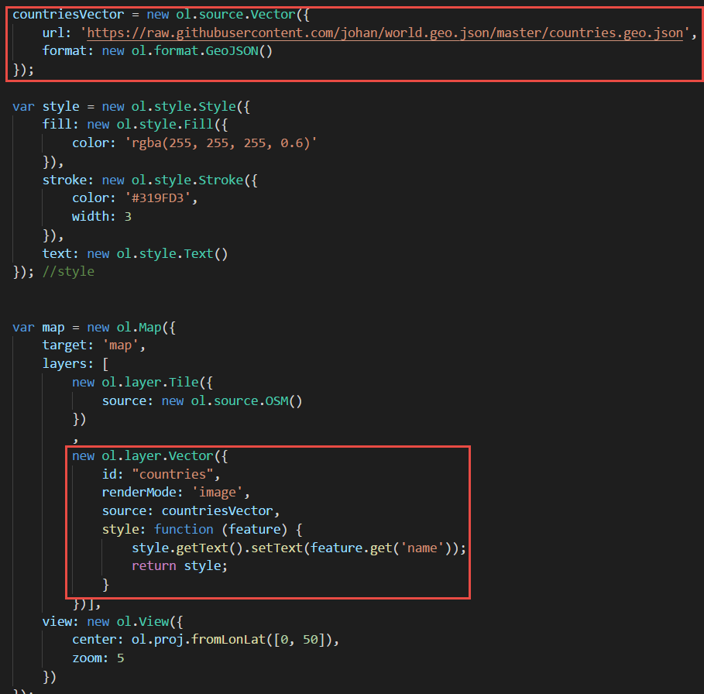
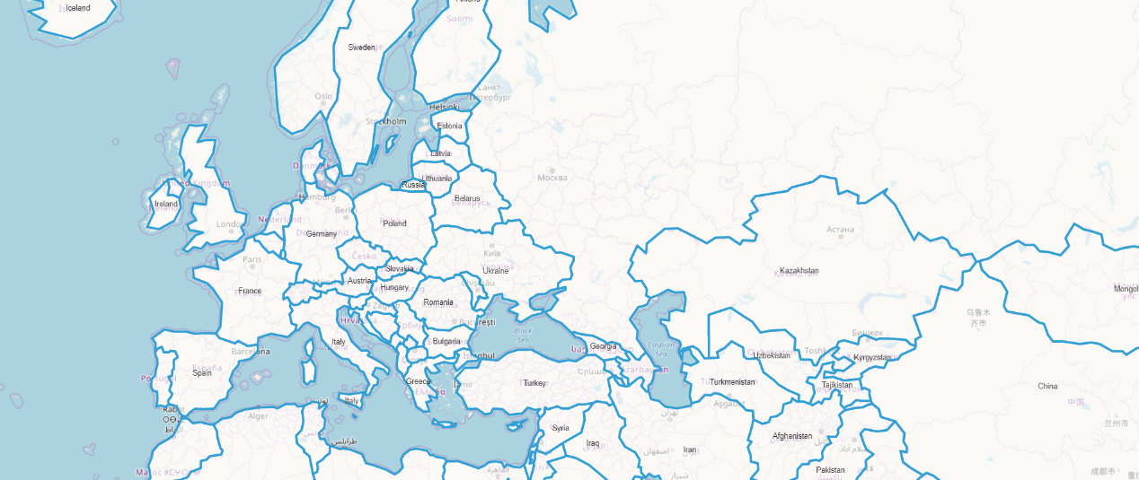
Step One: Show countries

Slide 10
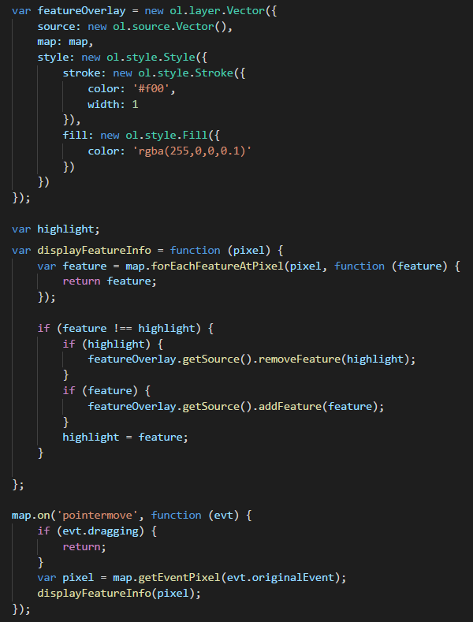
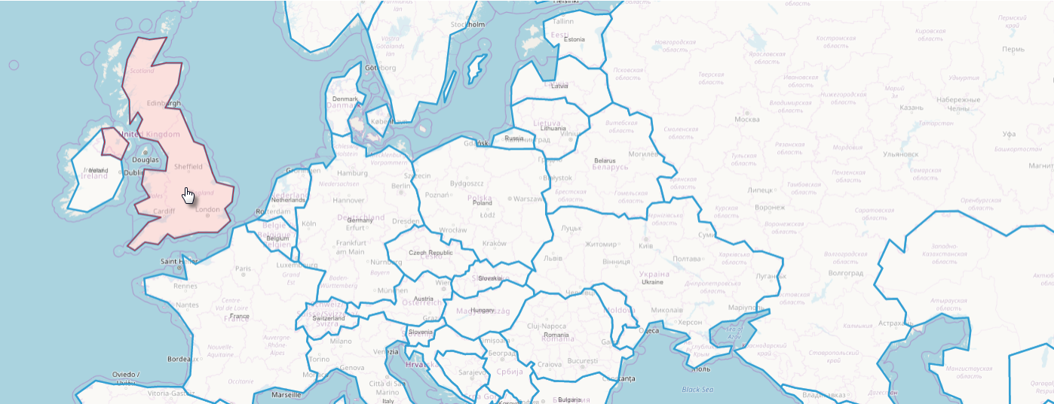
Step Two: highlight country when hovering over it

Slide 11
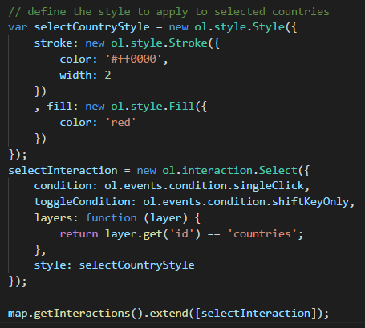
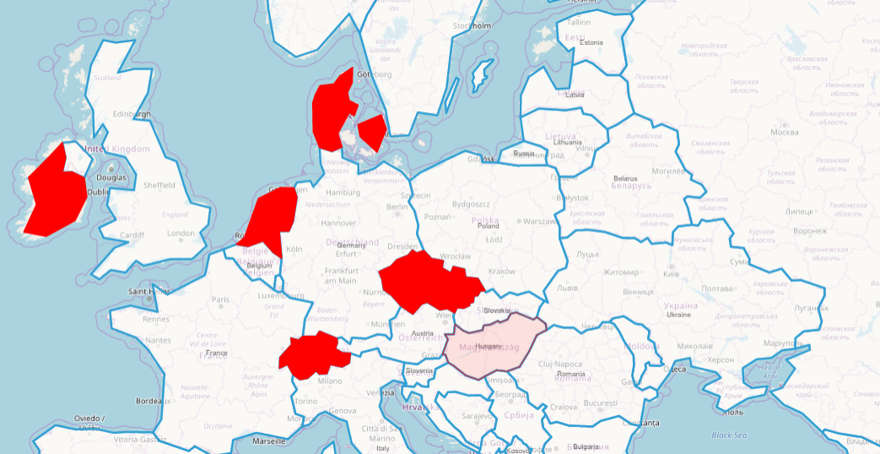
Step 3: Select countries

Slide 12
Integrate OpenLayers in JET Applications
Generic, application wide:
Create directory js/libs/openlayers
Extract resources from OpenLayers zip-distribution to this directory
Add entries for OpenLayers resource (js and css) to js/main-release-paths.json file
Configure OpenLayers in the RequireJS bootstrap file – typically main.js
In JET modules that use OpenLayers
Add container elements (typically DIV) in View (HTML)
Add JavaScript code in ViewModel to configure the OpenLayers map
Define layers and sources, views, styles, interactions and event handlers
Configure data binding between map and observables in ViewModel

Slide 13
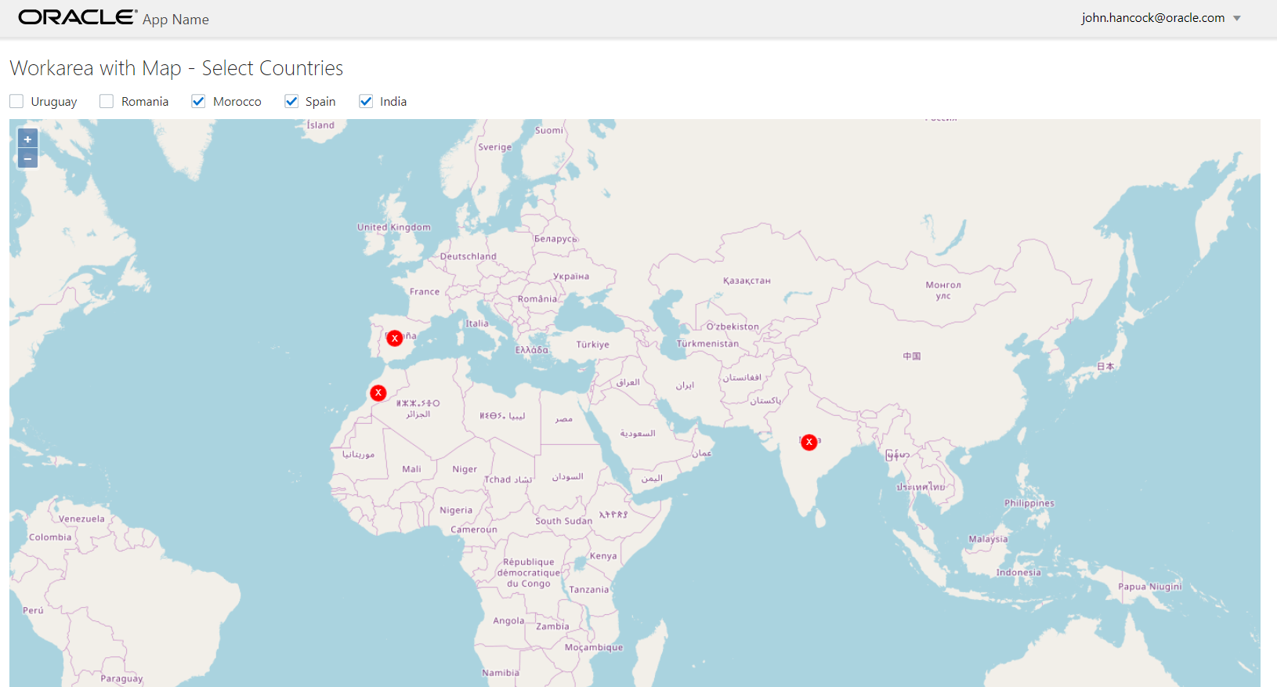
Demo OpenLayers in JET Applications

Slide 14
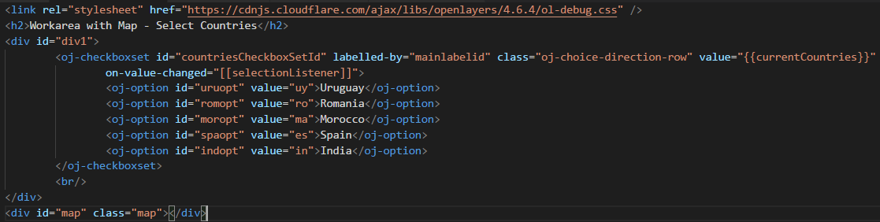
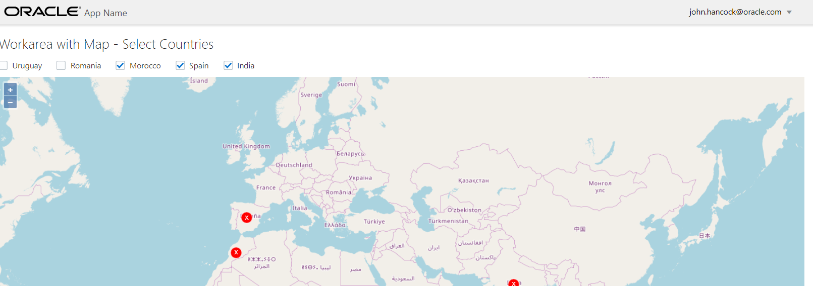
View – with Map container element and regular JET components

Slide 15
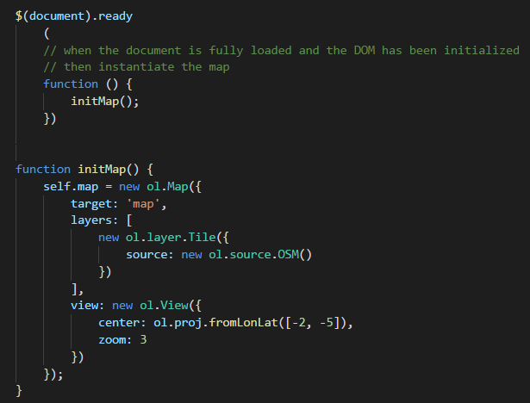
ViewModel – Initialize Map

Slide 16
ViewModel – what more?
Create a HashMap of OpenLayers features per country
Associate CheckboxSet with Change Event Listener
In the Event Listener:
Create a new Vector and Layer based on the current set of selected countries – picking the selected country features from the HashMap
Define the style to use for the country features
And associate this Layer with the map (after removing the current layer for selected countries)

Slide 17
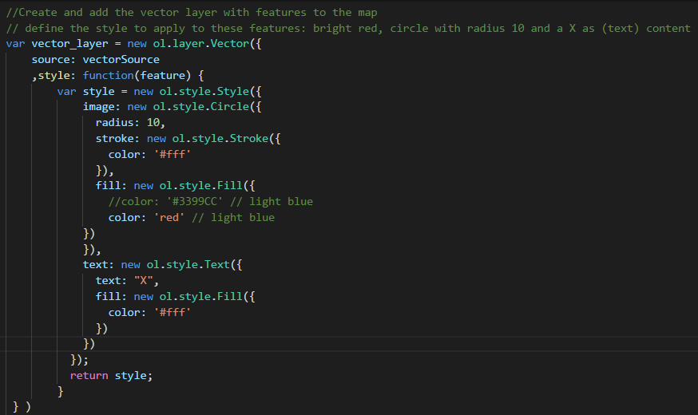
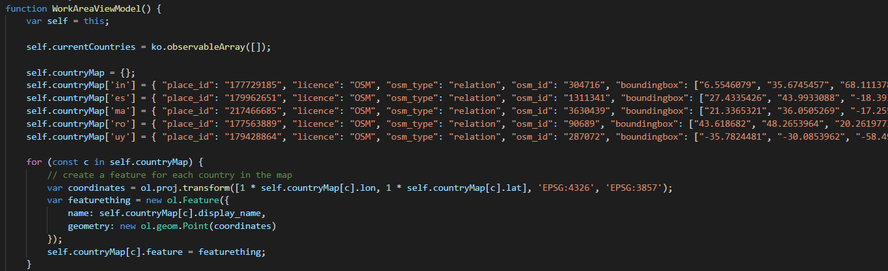
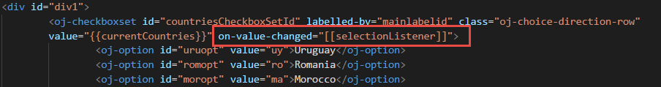
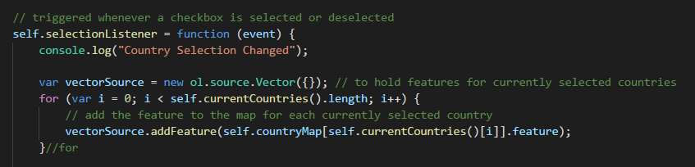
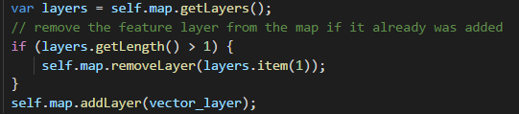
ViewModel – what more?
Create a HashMap of OpenLayers features per country
Associate CheckboxSet with Change Event Listener
In the Event Listener:
Create a new Vector and Layer based on the current set of selected countries – picking the selected country features from the HashMap
Define the style to use for the country features
And associate this Layer with the map (after removing the current layer for selected countries)
Creating Oracle JET Composite Conponents with OpenLayers?
17

Slide 18
Hands On OpenLayers and JET
Create a JET application
Download and add OpenLayers library
Configure JET application for using OpenLayers
Leverage OpenLayers
Add a world map to a JET module
Highlight countries selected in JET on the OpenLayers Map
Select countries by clicking on the map and pass the selection to the JET ViewModel
Embed OpenLayers component in JET Popup [for smooth user experience]
…. (anything you fancy and OpenLayers)

Slide 19
Introducing JET Composite Component Architecture (CCA): “A composite component is a reusable piece of UI that can be embedded as a custom HTML element and can be composed of other composites, JET components, HTML, JavaScript, or CSS.”
Notes:
http://www.oracle.com/webfolder/technetwork/jet/jetCookbook.html?component=composite&demo=basic

Slide 20
JET Composite Component
A reusable building block – encapsulated with a well defined interface
Created using HTML, CSS, JavaScript, JET resources, other CCA components
Packaged in a Zip file that can be shared with any application and any team
Easily ‘injected’ into a JET application
copy contents of zip-file to specific directory
And easily used in a page
Add tag to View
Load module in ViewModel
JET CCA
InputSmiley
My JET Application
Your JET Application
Page 1
Page 2
JET CCA
InputSmiley
JET CCA
InputSmiley
Page A
Page B
<input-smiley>
<input-smiley>
<input-smiley>
<input-smiley>
<input-smiley>
<input-smiley>
<input-smiley>

Slide 21
Constitution of a JET Composite Component
JET CCA
Component
UI (HTML + CSS)
Events, Property Updates, Function calls

Slide 22
Constitution of a JET Composite Component
JET CCA
Component
UI (HTML + CSS)
loader.js
view.html
Events, Property Updates, Function calls
component.json
styles.css
Other Resources
viewModel.js

Slide 23
Constitution of a JET Composite Component
Property values (can be Observables and callback functions), Function Calls
JET CCA
Component
UI (HTML + CSS)
loader.js
view.html
Events, Property Updates, Function calls
component.json
styles.css
Other Resources
viewModel.js

Slide 24
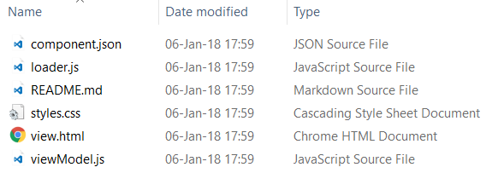
Steps for Creating a Composite Component
Use ojet create component <name of component>
This creates
A directory /js/jet-composites/<name of component>
The skeleton files for the composite component

Slide 25
Next Steps for Creating a Composite Component
Define output (view.html)
Define “logic” (viewModel.html)
Define properties (in component.json)
And wire up view aspects to those properties
And read & manipulate properties in viewModel
And make calls from viewModel to functions passed in as property
Define events (in component.json) that Component may publish
And write the logic to publish those events in viewModel
Define functions (in component.json) that Component exposes
And write the logic for these functions in viewModel
Add additional resources – CSS, Images, JavaScript – and add these to loader.js

Slide 26
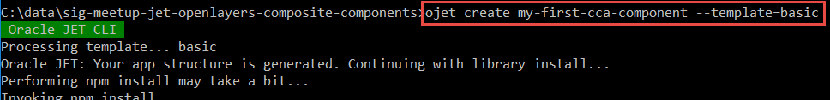
Simple Composite Component
Create new JET project:
Create new JET Composite Component hello-world:

Slide 27
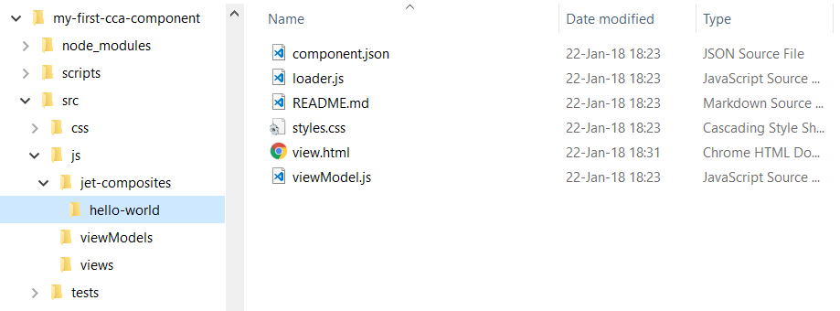
Component Workspace application plus virgin Hello World

Slide 28
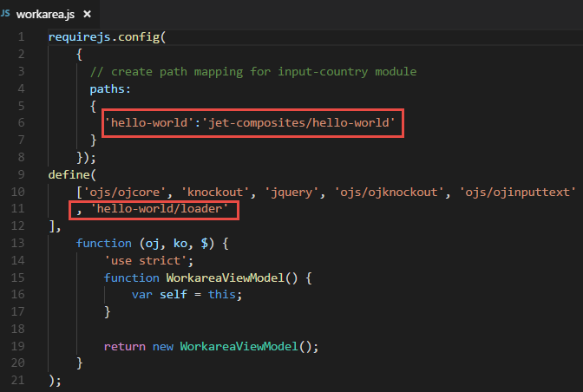
Include Component in Application
Create Module Workarea
workarea.js:
require.config paths
define hello-world/loader

Slide 29
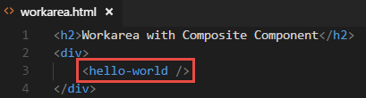
Include Component in Application
Create Module Workarea
workarea.js:
require.config paths
define hello-world/loader
workarea.html
add <hello-world>

Slide 30
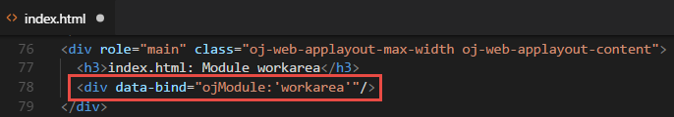
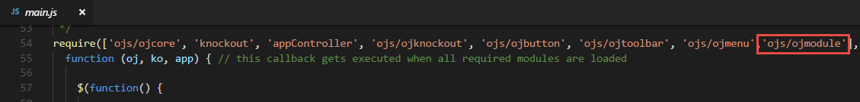
Include Component in Application
Create Module Workarea
workarea.js:
require.config paths
define hello-world/loader
workarea.html
add <hello-world>
Add Module Workarea
add module to index.html
add ojModule to main.js

Slide 31
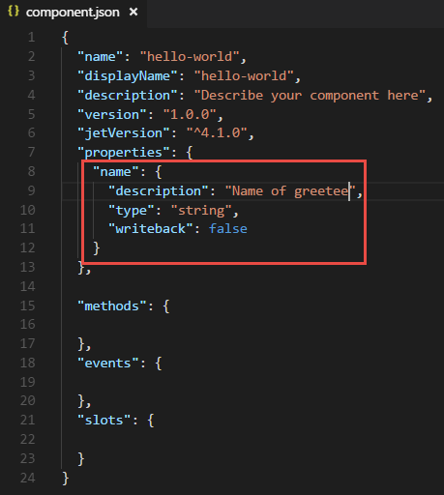
Define and use property
Add property in component.json

Slide 32
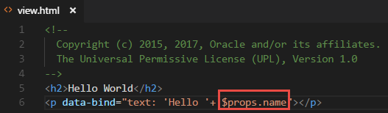
Define and use property (2)
Add property in component.json
Make use of property in view.html

Slide 33
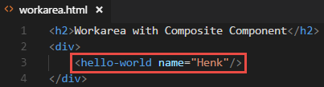
Define and use property (3)
Add property in component.json
Make use of property in view.html
Provide value of property in consuming application

Slide 34
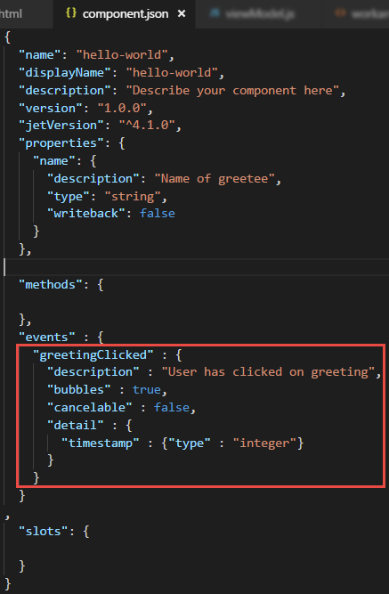
Publish Event from Component
Add event in component.json

Slide 35
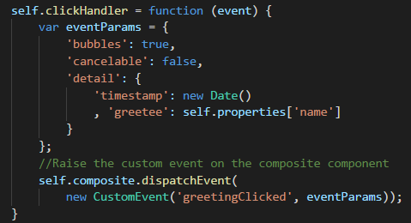
Publish Event from Component (2)
Add event in component.json
Publish event from viewModel.js

Slide 36
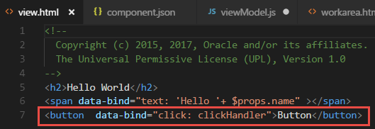
Publish Event from Component (3)
Add event in component.json
Publish event from viewModel.js
“Cause” event in view.html

Slide 37
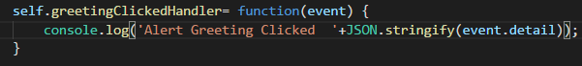
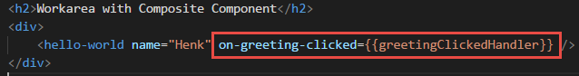
Consume Event in application
Define listener function in ViewModel
Configure event listener in View

Slide 38
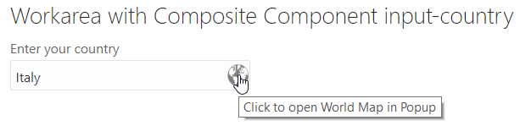
Hands On on JET Composite Components
Create simple CCA component
Consume (try out) CCA component in JET application

Slide 39
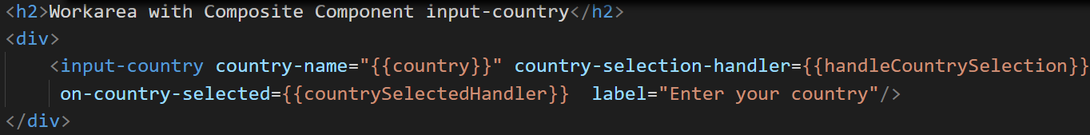
Hands On on JET Composite Components
Create simple CCA component
Consume (try out) CCA component in JET application
Enrich CCA component
Properties (two-way bound, call-back functions)
Embedded resources (images, CSS stylesheets, JavaScript libraries)
Events & Listeners
Expose functions to be invoked by component consumers
Embed OpenLayers in CCA Component
Add two-way country selection and event publication

Slide 40
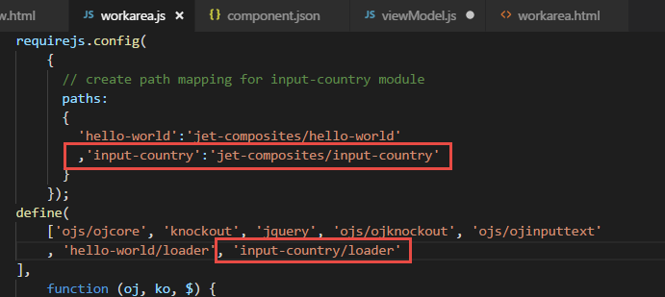
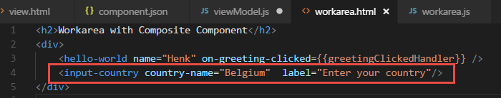
Demo consumption of “rich composite component”
Unzip to consuming application
Add to ViewModel
Add to View

Slide 41
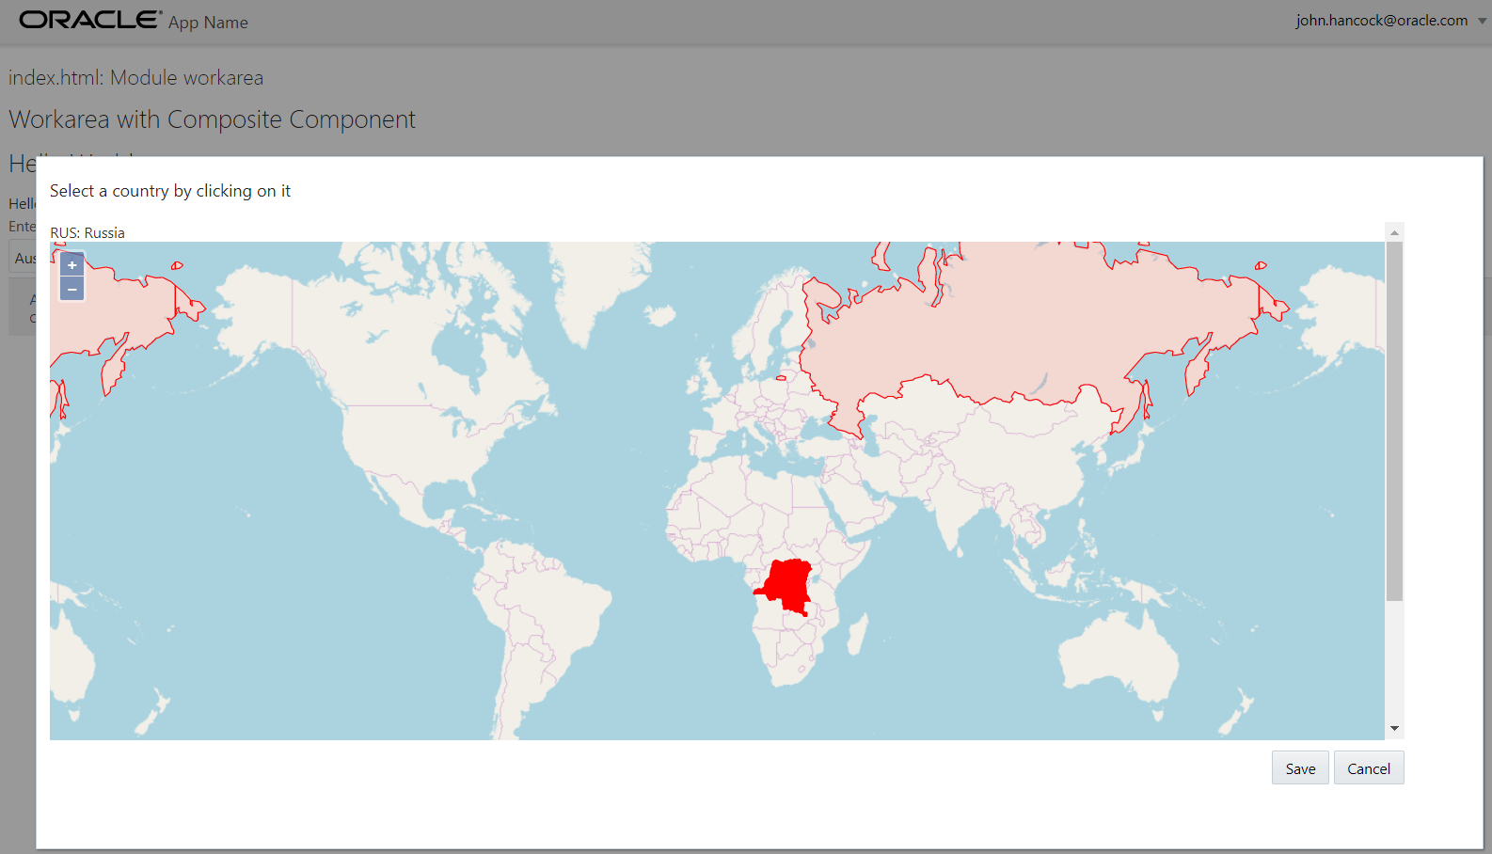

Slide 42




Thank you!
Blog: technology.amis.nl
Email: lucas.jellema@amis.nl
: @lucasjellema
: lucas-jellema
: www.amis.nl, info@amis.nl

